Slide 1
Linked Lists
Instructors:
Md Nazrul Islam Mondal &
Rizoan Toufiq
Department of Computer Science & Engineering
Rajshahi University of Engineering & Technology Rajshahi-6204

Slide 2
Outline
Introduction
Linked List
Representation of Linked Lists in Memory
Traversing a Linked List
Searching a Linked List
Memory Allocation; Garbage Collection
Insertion into a Linked List
Deletion from a Linked List
Header Linked List
Two Way Lists
Arrays, Records and Pointers

Slide 3
Header Linked List
Arrays, Records and Pointers

Slide 4
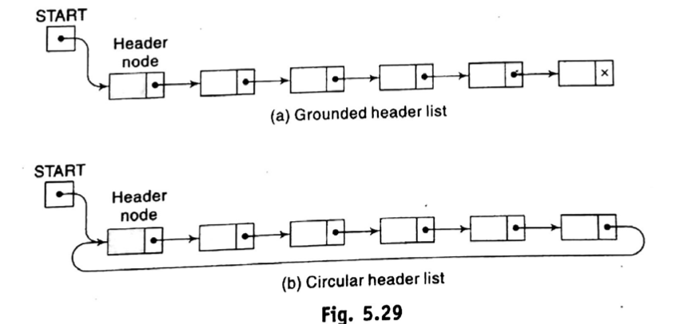
Header Linked List
Contains a special node, called the header node, at the beginning of the list.
  A grounded header list is a header list where the last node contains the null pointer.
  A circular header list is a header list where the last node points back to the header node.
Arrays, Records and Pointers

Slide 5
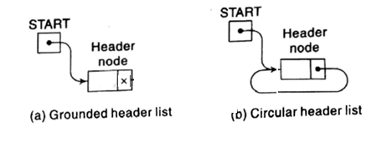
Header Linked List
Grounded header list is empty i.e. LINK[START]=NULL
Circular header list is empty i.e. LINK[START]=START
Arrays, Records and Pointers

Slide 6
Header Linked List
REMARK:
  Our header lists will always be circular.
  The header node acts as a sentinel indicating the end of the list. (No data in header node)
Arrays, Records and Pointers

Slide 7
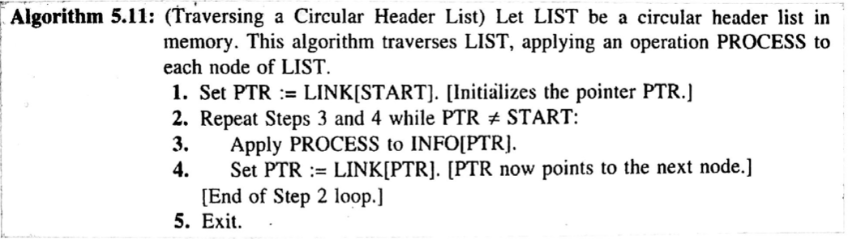
Header Linked List
Circular header list: Start traversing from LINK[START]
Arrays, Records and Pointers

Slide 8
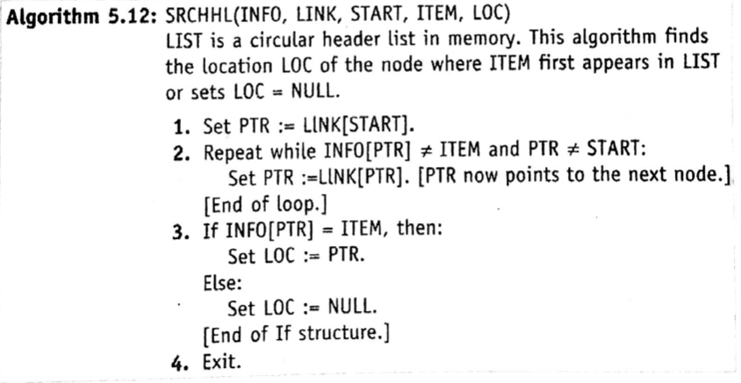
Header Linked List
Arrays, Records and Pointers

Slide 9
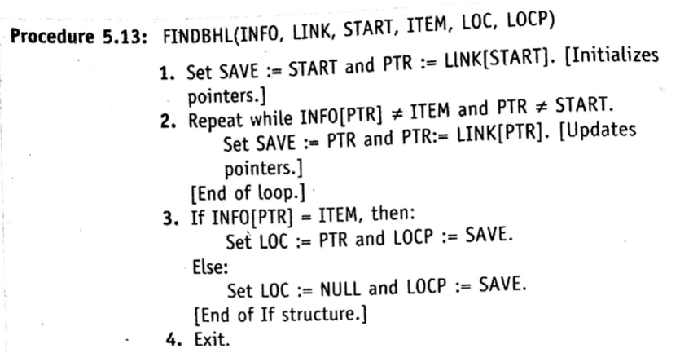
Header Linked List
Arrays, Records and Pointers

Slide 10
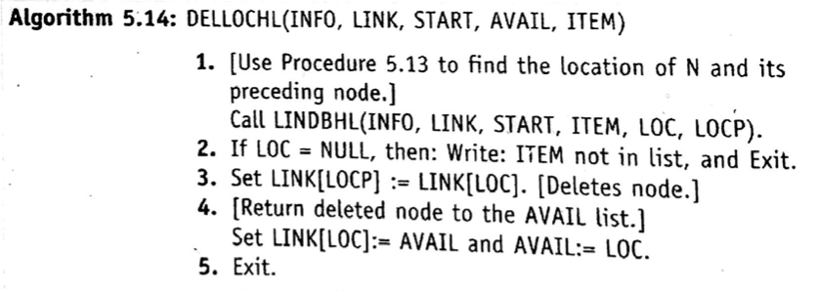
Header Linked List
Arrays, Records and Pointers

Slide 11
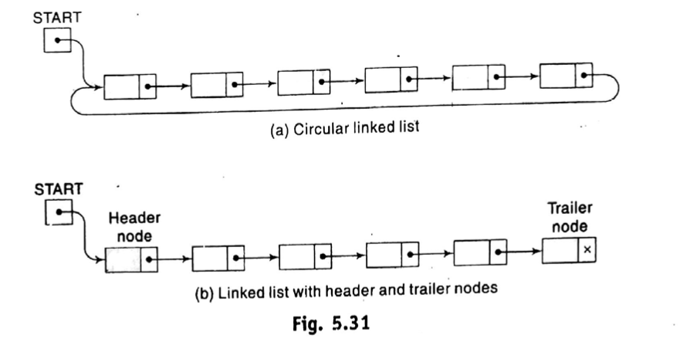
Header Linked List
Other two version of linked list
  A linked list whose last node points back to the first node instead of containing the null pointer, called a circular list.
  A linked list which contains both a special header node at the beginning of the list and a special trailer node at the end of the list.
Arrays, Records and Pointers

Slide 12
Two Way Lists
Arrays, Records and Pointers

Slide 13
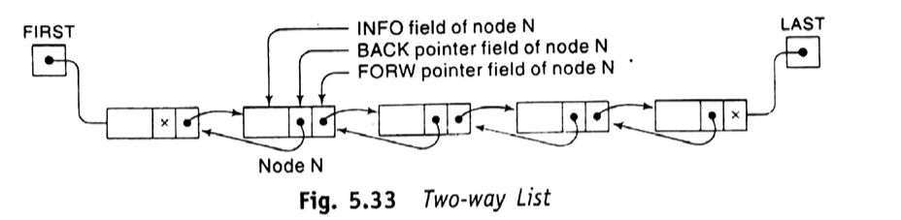
Two Way Lists
Arrays, Records and Pointers

Slide 14
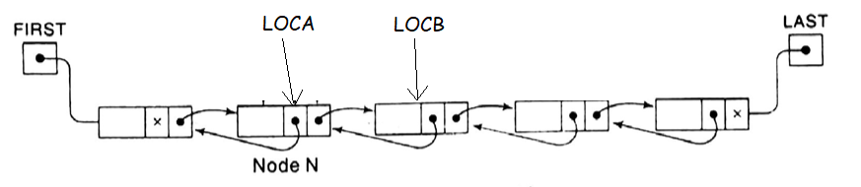
Two Way Lists
Pointer Property:
    FORW[LOCA] = LOCB if and only if BACK[LOCB]=LOCA
Arrays, Records and Pointers

Slide 15
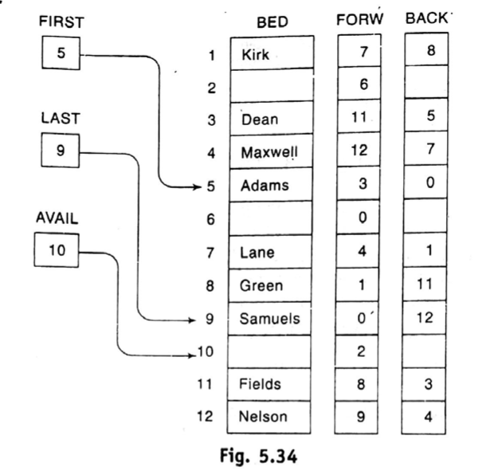
Two Way Lists
Arrays, Records and Pointers

Slide 16
Two Way Lists
(Traversing and Searching)
Traversing:
  Similar as one-way list or a header list
Searching
  Search for ITEM in the backward direction
  For example
    suppose LIST is a list of name sorted alphabetically.
    If ITEM = Smith, then we would search LIST in the backward direction.
    IF ITEM = Davis, then we would search LIST in the Forward direction.
Arrays, Records and Pointers

Slide 17
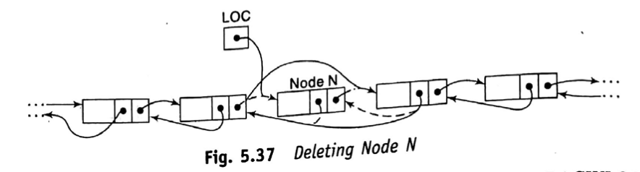
Two Way Lists
(Deleting)
Deleting:
  Given the location LOC of a node N in LIST.
  Want to delete N from the list.
  Consider, LIST is a two-way circular header list.
Arrays, Records and Pointers

Slide 18
Two Way Lists
(Deleting)
Deleting:
FORW[BACK[LOC]]:=FORW[LOC]
BACK[FORW[LOC]]:=BACK[LOC]
Arrays, Records and Pointers

Slide 19
Two Way Lists
(Deleting)
Deleting:
FORW[LOC]:=AVAIL
AVAIL:=LOC
Arrays, Records and Pointers

Slide 20
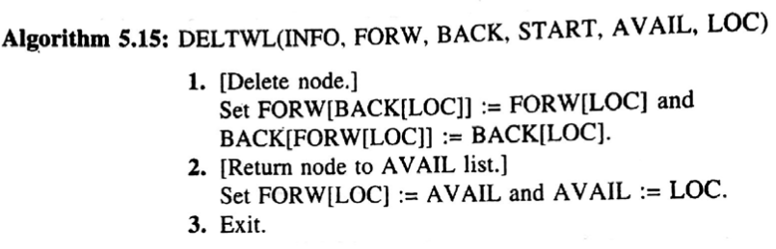
Two Way Lists
(Deleting)
Arrays, Records and Pointers

Slide 21
Two Way Lists
(Inserting)
Inserting:
  Given the location LOCA and LOCB of adjacent nodes A and B in LIST.
  Insert a given ITEM of information between nodes A and B.
  First we remove the first node N from the AVAIL list, using the variable NEW to keep track of its location, and then we copy the data ITEM into the node N.
        NEW:=AVAIL,
        AVAIL:=FORW[AVAIL],
        INFO[NEW]:=ITEM
Arrays, Records and Pointers

Slide 22
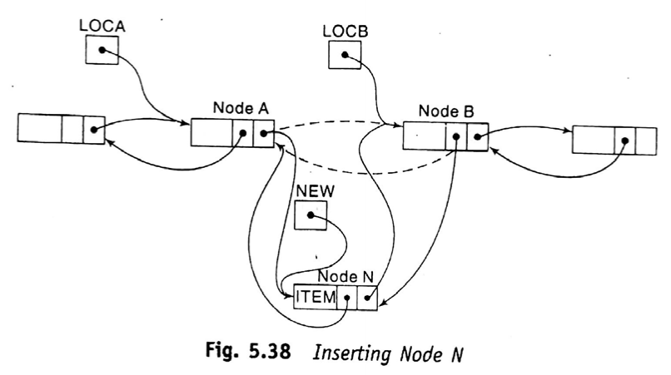
Two Way Lists
(Inserting)
FORW[LOCA]:=NEW
BACK[LOCAB]:=NEW
BACK[NEW]:=LOCA
FORW[NEW]:=LOCB
Arrays, Records and Pointers

Slide 23
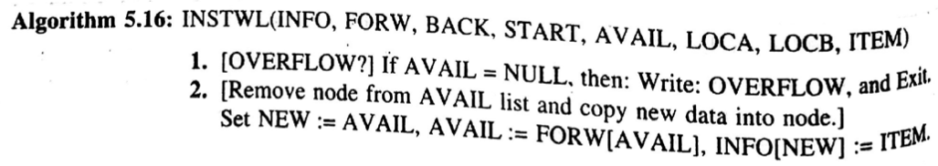
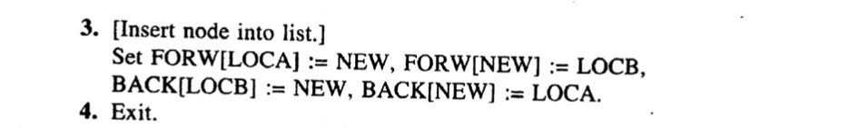
Two Way Lists
(Inserting)
Arrays, Records and Pointers

Slide 24
END
Arrays, Records and Pointers

